Slide 1
Programmable Interval Timer (8254)
Farhan Sadaf
Lecturer, Dept. of CSE

Slide 2
8254 Programmable Interval Timer
The 8254 is a programmable interval timer/counter designed for use with Intel microcomputer systems.
It is a general purpose, multi-timing element that can be treated as an array of I/O ports in the system software.
The 8254 solves one of the most common problems in any microcomputer system, the generation of accurate time delays under software control.
Instead of setting up timing loops in software, the programmer configures the 8254 to match his requirements and programs one of the counters for the desired delay.

Slide 3
8254 Programmable Interval Timer
After the desired delay, the 8254 will interrupt the CPU.
Software overhead is minimal and variable length delays can easily be accommodated.

Slide 4
Programmable counter/ Interval timer
Required to generate:
accurate time delay
event counting
rate generation
complex wave form generation
complex motor control
etc. under software control
Also used in personal computer to generate:
18.2 timer interrupts per seconds,
refresh RAM at regular intervals,
provides timer signals to other devices

Slide 5
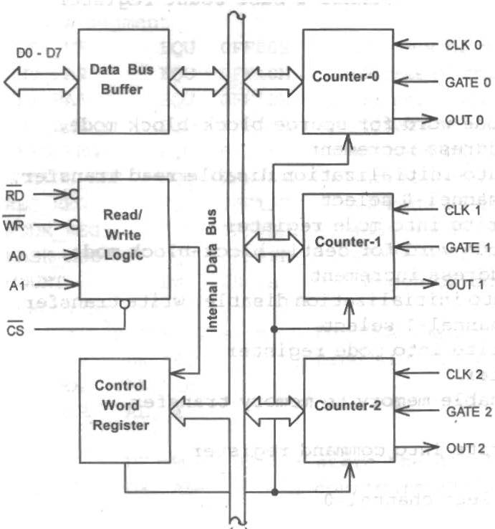
Internal Block Diagram (8254)
Contains:
Data bus buffer
Is a bidirectional, 8-bit buffer
Read/ write logic
Accepts input from the system bus and generates control signal for the other functional blocks
A control word register and Three 16 bit counters
Each counter is individually programmed to operate in different modes and by writing separate control into the control word register.

Slide 6
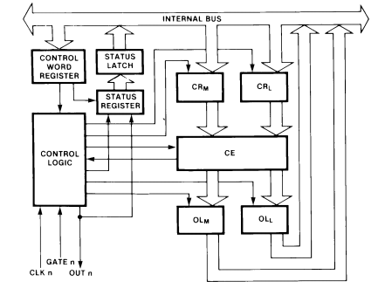
Internal Block Diagram (Counter)

Slide 7
Internal Block Diagram (Counter)
The Counters are fully independent. Each Counter may operate in a different Mode.
The Control Word Register is shown in the figure; it is not part of the Counter itself, but its contents determine how the Counter operates.
The status register, shown in Figure contains the current contents of the Control Word Register and status of the output and null count flag.
The actual counter is labelled CE (for ‘‘Counting Element’’). It is a 16-bit presettable synchronous down counter.

Slide 8
Internal Block Diagram (Counter)
OLM and OLL are two 8-bit latches. OL stands for ‘‘Output Latch’’. the subscripts M and L stand for ‘‘Most significant byte’’ and ‘‘Least significant byte’’.
Similarly, there are two 8-bit registers called CRM and CRL (for ‘‘Count Register’’).
The Control Logic is also shown in the diagram. CLK n, GATE n, and OUT n are all connected to the outside world through the Control Logic.

Slide 9
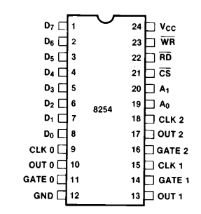
Pins and Signals(8254)

Slide 10
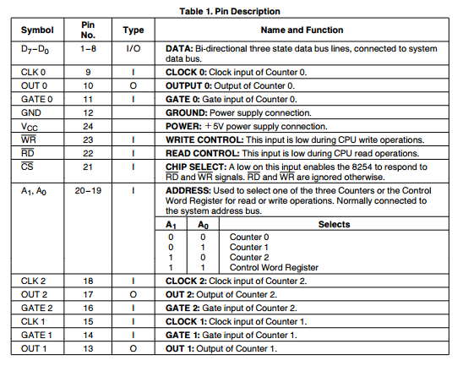
Pins and Signals(8254)

Slide 11
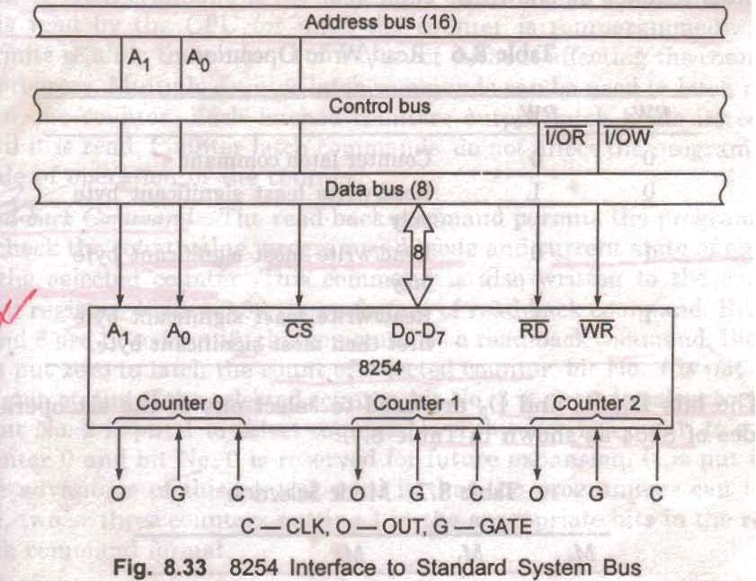
Interfacing with the system bus(8254)

Slide 12
Operational Description
After power-up, the state of the 8254 is undefined. The Mode, count value, and output of all Counters are undefined.
How each Counter operates is determined when it is programmed. Each Counter must be programmed before it can be used.
Counters are programmed by writing a Control Word and then an initial count.

Slide 13
Operational Description
The Control Words are written into the Control Word Register, which is selected when A1,A0=11. The Control Word itself specifies which Counter is being programmed.
By contrast, initial counts are written into the Counters, not the Control Word Register. The A1,A0 inputs are used to select the Counter to be written into. The format of the initial count is determined by the Control Word used.

Slide 14
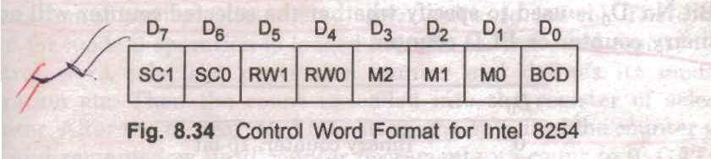
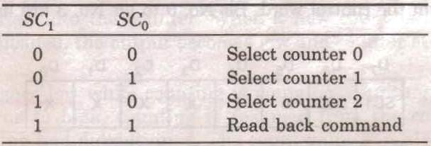
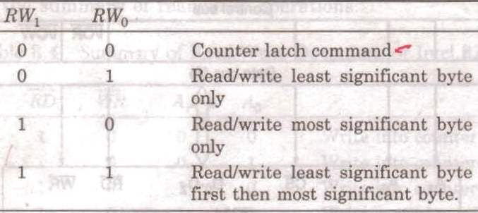
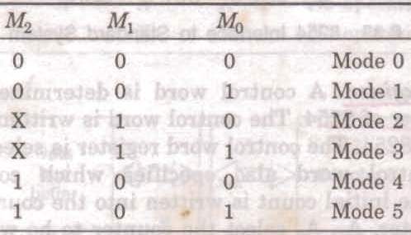
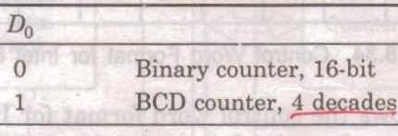
Control Word Register (8254)
Is determined to select and program a counter of 8254

Slide 15
Write Operations
The programming procedure for the 8254 is very flexible. Only two conventions need to be remembered: 1) For each Counter, the Control Word must be written before the initial count is written. 2) The initial count must follow the count format specified in the Control Word (least significant byte only, most significant byte only, or least significant byte and then most significant byte).

Slide 16
Read Operations
There are three possible methods for reading the counters: Simple Read Operation, the Counter Latch Command, and the Read-Back Command.
Simple Read Operations
The first method is to perform a simple read operation. To read the Counter, which is selected with the A1, A0 inputs, the CLK input of the selected Counter must be inhibited by using either the GATE input or external logic. Otherwise, the count may be in the process of changing when it is read, giving an undefined result.

Slide 17
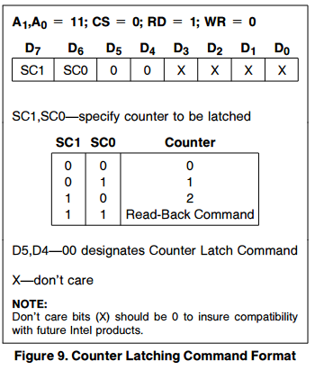
Counter Latch Command (8254)
Like a Control Word, this command is written to the Control Word Register, which is selected when A1,A0 = 11. Also like a Control Word, the SC0, SC1 bits select one of the three Counters, but two other bits, D5 and D4, distinguish this command from a Control Word.

Slide 18
Counter Latch Command (8254)
The selected Counter’s output latch (OL) latches the count at the time the Counter Latch Command is received.
This count is held in the latch until it is read by the CPU (or until the Counter is reprogrammed).
The count is then unlatched automatically and the OL returns to ‘‘following’’ the counting element (CE).
Multiple counter latch commands can be used to latch more than one counter.
Counter latch commands do not affect the programmed mode of operation of the counter.

Slide 19
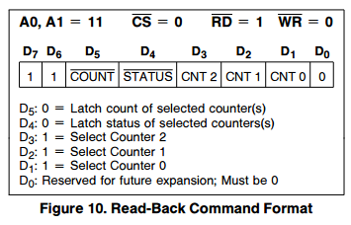
Read back command (8254)
It permits the programmer to check the count value, programmed mode and current status of output of the selected counter.
The command is written into the Control Word Register and has the format shown in Figure . The command applies to the counters selected by setting their corresponding bits D3, D2, D1 = 1.

Slide 20
Read back command (8254)
The read-back command may be used to latch multiple counter output latches (OL) by setting the COUNT bit D5 = 0 and selecting the desired counter(s).
Each counter’s latched count is held until it is read (or the counter is reprogrammed).
The counter is automatically unlatched when read, but other counters remain latched until they are read.
If multiple count read-back commands are issued to the same counter without reading the count, all but the first are ignored; i.e., the count which will be read is the count at the time the first read-back command was issued.

Slide 21
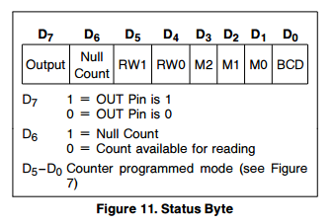
Read back command (8254)
The read-back command may be used to latch status information by setting the STATUS bit D4 = 0 and selecting the desired counter(s).
Status must be latched to be read. Status of a counter is accessed by a read from the counter.

Slide 22
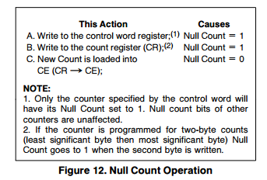
Read back command (8254)
NULL COUNT bit D6 indicates when the last count written to the counter register (CR) has been loaded into the counting element (CE).
Until the count is loaded into the counting element (CE), it can’t be read from the counter.

Slide 23
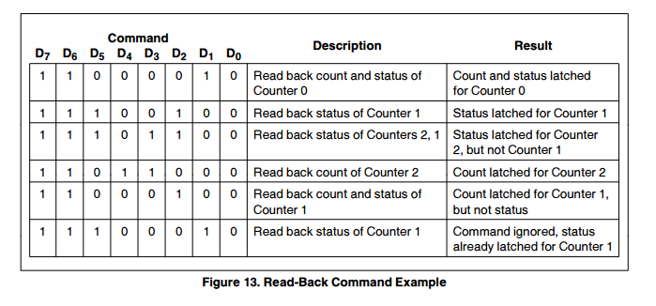
Read back command (8254)

Slide 24
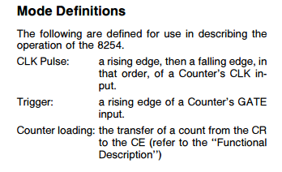
Mode Definitions

Slide 25
Modes of Operation: Mode-0: interrupt on terminal count
Mode 0 is typically used for event counting.
After the Control Word is written, OUT is initially low, and will remain low until the Counter reaches zero. OUT then goes high and remains high until a new count or a new Mode 0 Control Word is written into the Counter.
GATE =1 enables counting; GATE = 0 disables counting. GATE has no effect on OUT.
After the Control Word and initial count are written to a Counter, the initial count will be loaded on the next CLK pulse. This CLK pulse does not decrement the count, so for an initial count of N, OUT does not go high until N +1 CLK pulses after the initial count is written.

Slide 26
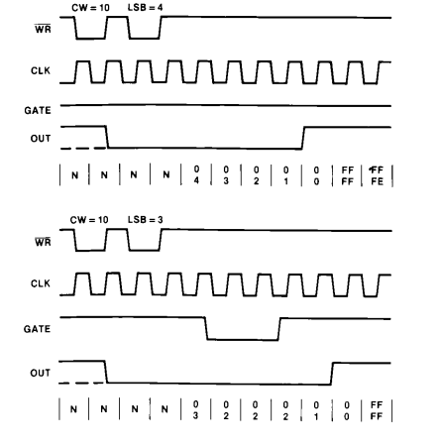
Modes of Operation: Mode-0: interrupt on terminal count

Slide 27
Modes of Operation: Mode-1: Hardware retrigger able one-shot
A trigger signal in GATE activates the counting.
OUT will be initially high. OUT will go low on the CLK pulse following a trigger and will remain low until the Counter reaches zero.
If GATE is triggered again in between counting, then the counter reloaded and starts counting from the beginning. Thus called retrigger able.
If a new count is written while output is low, then the current one-shot has no affect unless the counter is retriggered.

Slide 28
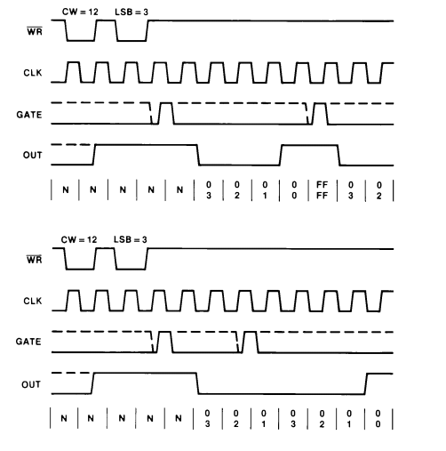
Modes of Operation: Mode-1: Hardware retrigger able one-shot

Slide 29
Modes of Operation: Mode-2: Rate generator
In this mode the counter acts as a divide by N counter
The GATE has to be kept high.
The counting starts after loading the count value.
The output remains high for N-1 clock cycles and then goes low for one clock cycle.
The process is repeated until the GATE goes low and starts from the beginning when GATE goes high again.
If a new count is loaded in between counting, then the new value take affect from the subsequence of counting.

Slide 30
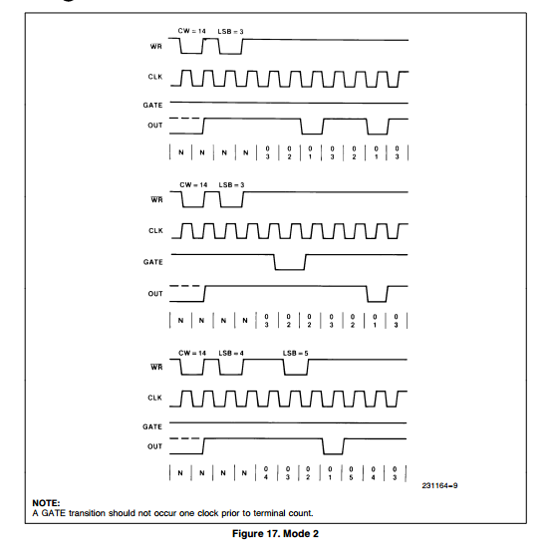
Modes of Operation: Mode-2: Rate generator

Slide 31
See yourself
Mode 3 : Square Wave Mode.
Mode 4 : Software Triggered Strobe.
Mode 5 : Hardware Triggered Strobe.

Slide 32
Thank You

